Slide 1
DESIGN PATTERNS

Slide 2
What are Design Patterns?
In software engineering, a design pattern is a general repeatable solution to a commonly occurring problem in software design. A design pattern isn't a finished design that can be transformed directly into code. It is a description or template for how to solve a problem that can be used in many different situations.

Slide 3
Types of Design Patterns
Creational Patterns
  These patterns provide flexible ways of creating objects, which help to minimize dependencies between classes and maximize code reuse.
Structural Patterns
  These patterns help you to structure your classes efficiently, making relations between classes minimal and straightforward.
Behavioral Patterns
  These patterns are responsible for the efficient and safe distribution of behaviors among the program's objects.

Slide 4
Creational Design Patterns
Abstract Factory
Builder
Factory
Prototype
Singleton

Slide 5
Singleton
Singleton is a creational design pattern that lets you ensure two things:
  a class has only one instance
  a global access point to this instance.

Slide 6
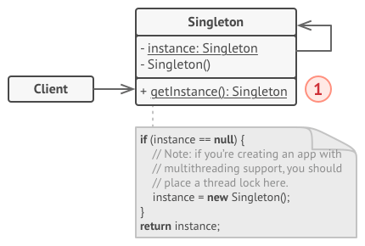
Solution to Singleton Pattern
Making the default constructor private.
Creating a static creation method that will act as a constructor. This method creates an object using the private constructor and saves it in static variable or field. All following calls to this method return the cached object.

Slide 7
Prototype
Prototype is a creational design pattern that lets you produce new objects by copying existing ones without compromising their internals.

Slide 8
Solution to Prototype Pattern
By implementing a clone method. The method creates an object of a current class and copies all its field values into the new object. Most of the programming languages allow accessing private fields in an object of the same class, so the copying process is straightforward.

Slide 9
Builder Pattern
Builder is a creational design pattern that lets you produce different types and representations of an object using the same building process. Builder allows constructing complex objects step by step.

Slide 10
Solution to Builder Pattern
This pattern organizes the object construction into a set of steps. To create an object, you will need to call several building steps in a builder class. The important part here is that you do not need to call all the steps. You can use only the steps necessary for producing a particular configuration of an object.

Slide 11
Abstract Factory Pattern
Abstract Factory is a creational design pattern that lets you produce families of related objects without specifying their concrete classes.

Slide 12
Solution to Abstract Factory

Slide 13
Factory Pattern
Factory Method is a creational design pattern that provides an interface for creating objects in superclass, but allow subclasses to alter the type of objects that will be created.

Slide 14
Solution to Factory Pattern
The Factory Method pattern suggests replacing direct object creation (using a new operator) with a call to a special "factory" method. The constructor call should be moved inside that method. Objects returned by factory methods are often referred to as "products."

